Slide 1
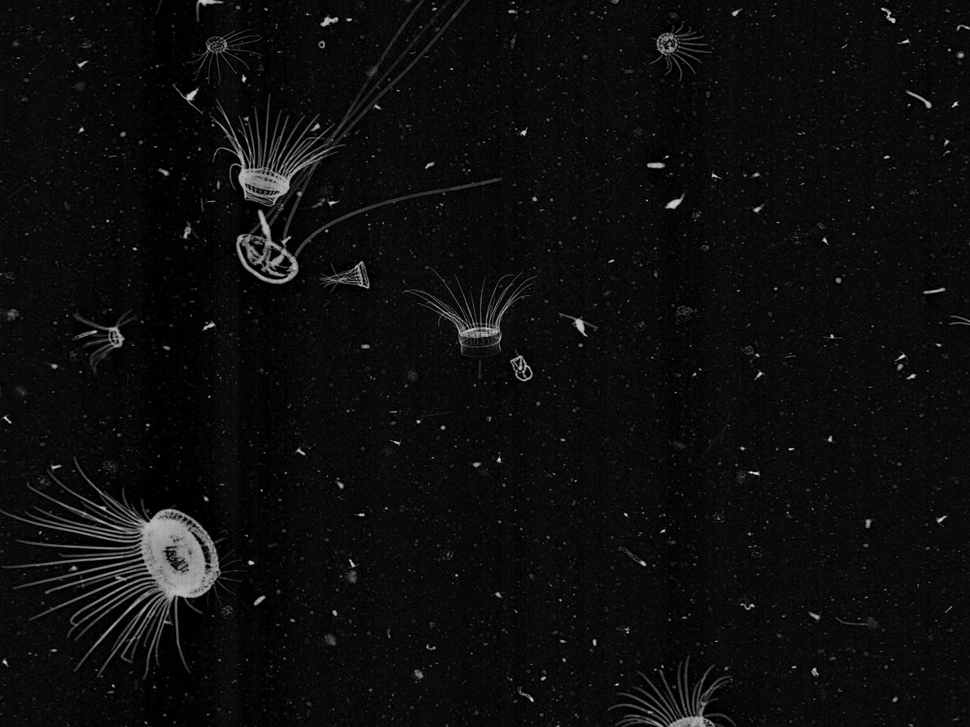
Classifying plankton with deep neural networks
Sander Dieleman – September 22nd, 2015

Slide 2
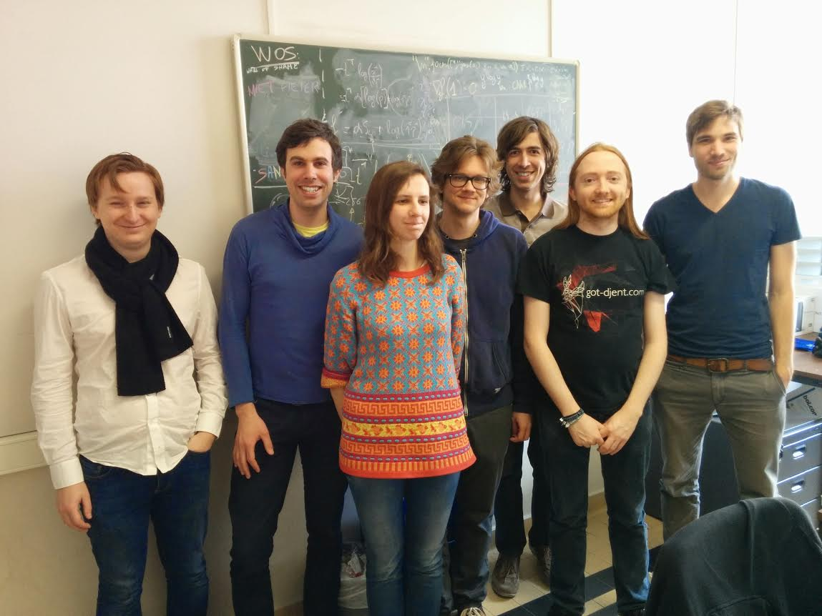
Jeroen
Aäron
Pieter
Lionel
Sander
Jonas
Iryna

Slide 3
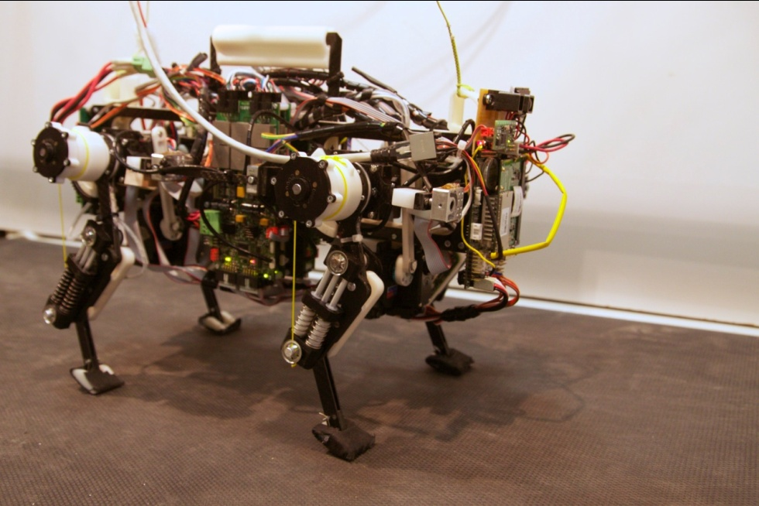
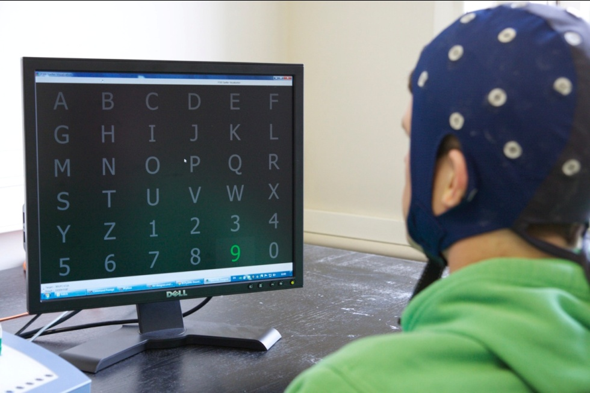
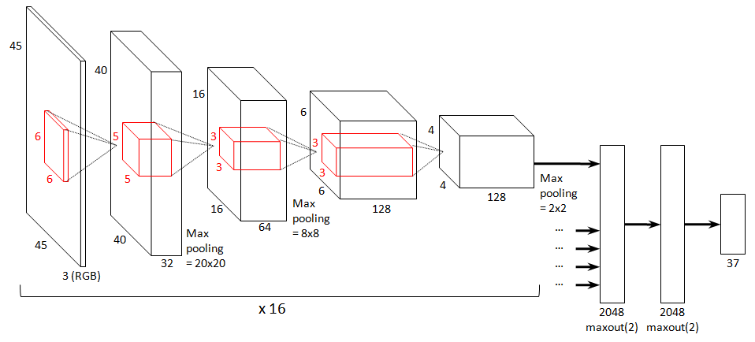
Reservoir Lab

Slide 4

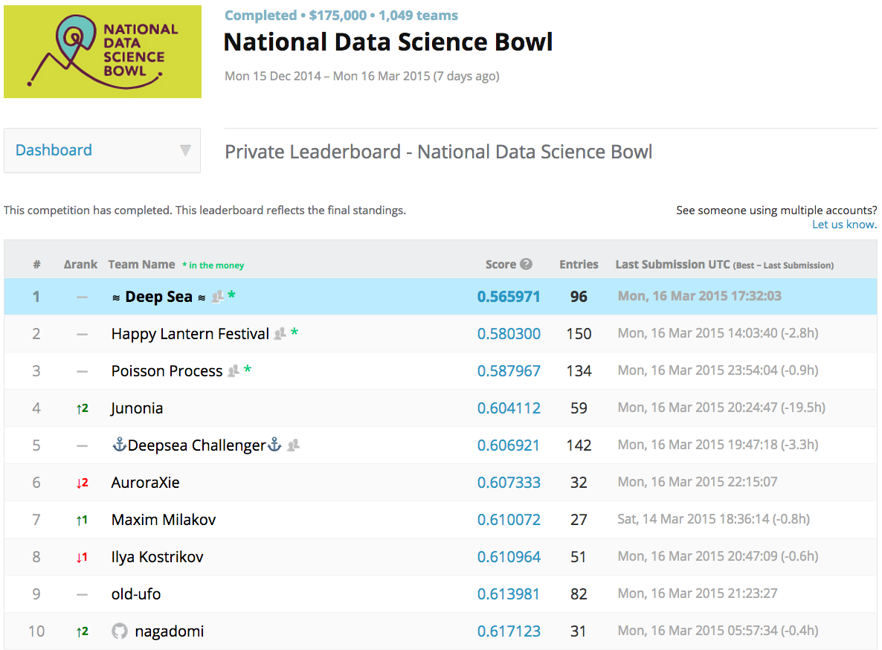

Slide 5
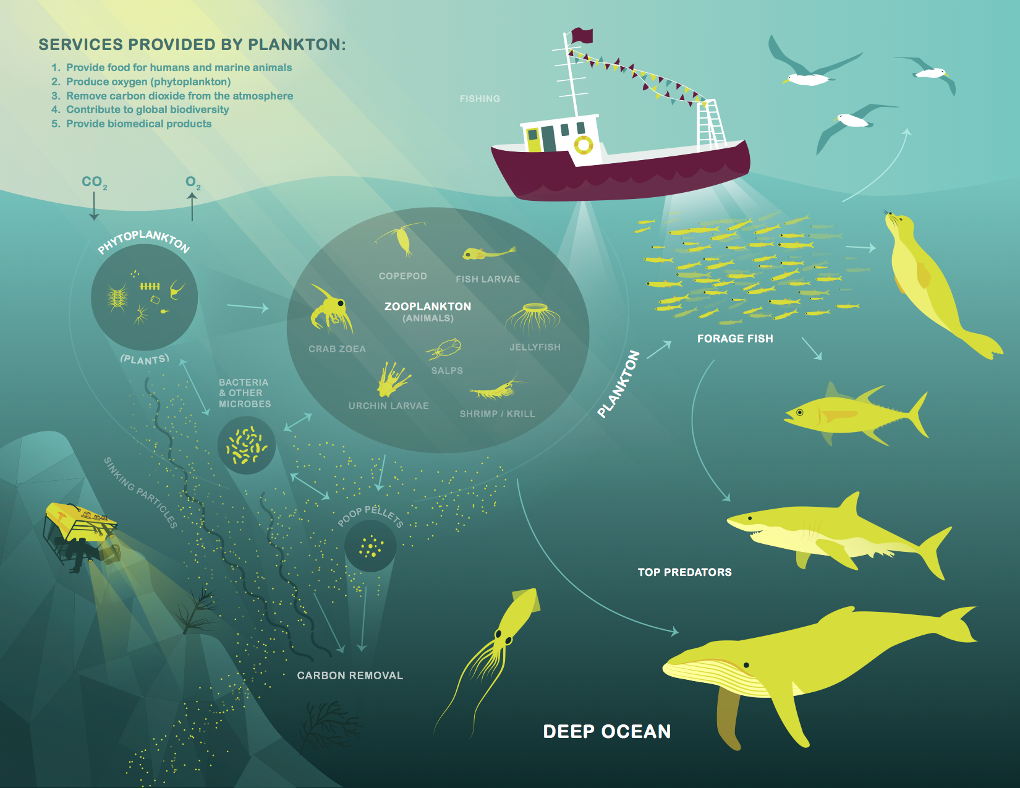
Notes:
measure ecosystem health by counting plankton species.
to be able to count them, we have to identify them first!

Slide 6
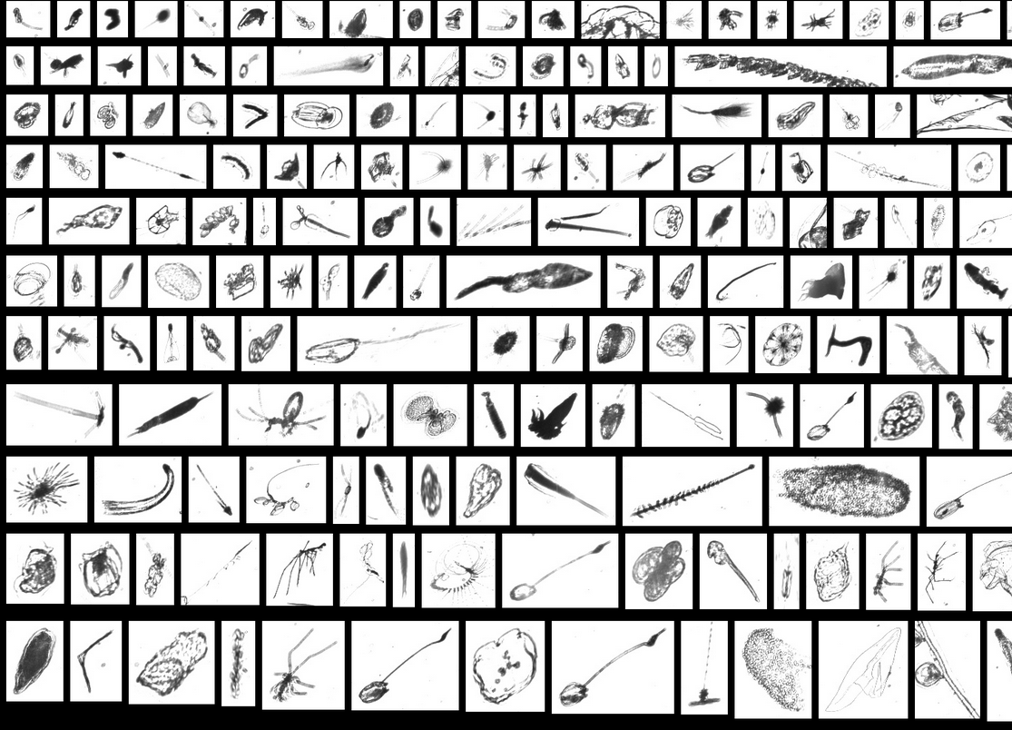
Notes:
Make sure to mention rescaling
+ 121 classes, 33k training, 100k testing

Slide 7
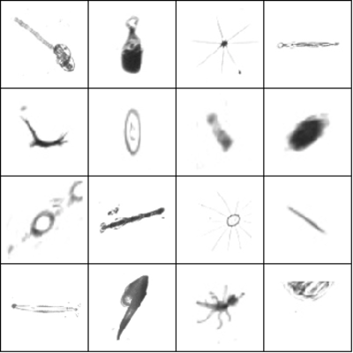
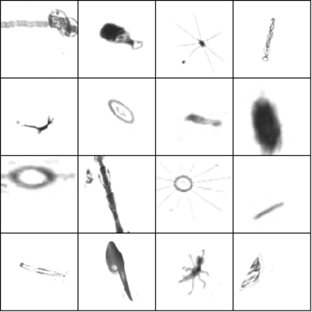
Preprocessing and data augmentation
rescale
zoom, rotate, translate,
flip, shear, stretch

Slide 8
‘Shallow’ learning
x_{n}
ɸ_{n}
f_{θ}(ɸ_{n})
y_{n}
training examples
extracted features
shallow model
predictions

Slide 9
Deep learning
x_{n}
f_{θk}(…f_{θ2}(f_{θ1}(x_{n})))
y_{n}
training examples
deep model
predictions

Slide 10
Deep learning vs. traditional neural networks
output layer
hidden layer
Notes:
Let’s look at what modern deep learning entails, from a very pragmatic standpoint, and how it differs from traditional neural networks.
Here’s a traditional neural net from the 80’s/90’s: it’s got one hidden layer with a bunch of units, and an output layer that predicts the target variables. It uses sigmoid or tanh activation functions.

Slide 11
Deep learning vs. traditional neural networks
output layer
hidden layers
Notes:
Deep learning: make the network ‘deeper’ by adding more hidden layers that compute progressively more complex feature representations from the input.
PROBLEM: sigmoid units saturate, which leads to the ‘vanishing gradient problem’: the gradient is unable to pass through all the way to the input. Each layer gets a progressively smaller learning signal, so the lowest layers don’t learn anything.

Slide 12
Deep learning vs. traditional neural networks
output layer
hidden layers
unsupervised pre-training
RBMs, auto-encoders
Notes:
Until recently, the best way to mitigate this problem was to do layerwise unsupervised pretraining.
Train RBMs or autoencoders layer by layer. RBMs try to build a probabilistic model of the input. Autoencoders are neural networks that try to predict the input.
Once such a layer is learnt, we can represent the input by its hidden layer representation, and repeat the process.
The layer can then be stacked into a ‘regular’ neural network, which can then by finetuned by backpropagation. This works because the weights are now initialised in a better range, where the vanishing gradient problem isn’t as big an issue.
Another advantage of pre-training is that it allows the incorporation of unlabeled data in the training process. This is usually easier to come by than labeled data.

Slide 13
Deep learning vs. traditional neural networks
output layer
hidden layers

Slide 14
Deep learning vs. traditional neural networks
output layer
hidden layers
rectified linear units
y = max(x, 0)
Notes:
Rectified linear units: alternative activation function. It’s piecewise linear, so the vanishing gradient problem is less of an issue. No pre-training needed. The sigmoid is usually kept in the top layer for classification (or it can be replaced by an SVM), or a linear output layer can be used for regression tasks.

Slide 15
Deep learning vs. traditional neural networks
output layer
hidden layers
Notes:
More computational power available these days (better CPUs, now we have GPUs as well) => bigger hidden layers with more parameters.
As a result, overfitting is a bigger concern. New regularization methods have also helped make bigger nets a possibility. Dropout is the most important one, we’ll go into that later.

Slide 16
Convolutional neural networks
local connectivity
flatten
translation invariance
fully connected
convolutional
Notes:
http://cs231n.github.io/convolutional-networks/ for more details

Slide 17
A brief history of deep learning
2006
unsupervised pre-training with RBMs
2007
unsupervised pre-training with auto-encoders
2010
rectified linear units (ReLUs)
2012
dropout regularization
2012
Alex Krizhevsky wins ImageNet by a large margin
Notes:
Alex used the new techniques (ReLUs, dropout) to get his result. He did not use any form of pre-training.
+ mention recent popularity of RNNs / LSTMs
Around 2010-2012, a shift happened: focus shifted to supervised learning again, pre-training went out of fashion, industry took notice. And after Krizhevsky’s result, everyone started using convnets.
This is where we are right now. Commercial deep learning is dominated by purely supervised approaches (after all, Google, Microsoft and Facebook have the labeled data they need). Most deep learning gurus (mainly Yoshua Bengio, but also the other guys) still believe that unsupervised learning is going to be more important in the long term, but for now, supervised approaches get the best practical results.

Slide 18
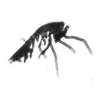
Network architecture based on OxfordNet
3x3 convolution
3x3 overlapping pooling, stride 2
fully connected layer
Very Deep Convolutional Networks for Large-Scale Image Recognition, Simonyan & Zisserman, ICLR 2015

Slide 19
Architecture variants: multiscale input
Fixed scale input
3x3 convolution
3x3 pooling, stride 2
fully connected layer
Notes:
Neural networks used to be either stacks (feed-forward) or loops (recurrent). Nowadays they are more like machine learning lego: you can put together differentiable ‘blocks’ in any configuration, and because they are differentiable, you can backpropagate through this structure.
This allows for more complex layouts like trees and DAGs.
This is an example of a tree-structured network.

Slide 20
Our competitive edge
Cyclic pooling and ‘rolling’
Pseudo-labeling
Very leaky ReLUs
Incorporating traditional computer vision features
Extensive model averaging

Slide 21




Cyclic pooling
0°
90°
180°
270°

Slide 22
Cyclic pooling
3x3 convolution
cyclic slicing
3x3 pooling, stride 2
cyclic pooling
fully connected layer

Slide 23
Cyclic ‘rolling’
0°
90°
180°
270°
Notes:
+ custom CUDA kernels

Slide 24
Pseudo-labeling
averaged test set predictions
...
test set predictions from various models
Notes:
link to dark knowledge etc.

Slide 25
Pseudo-labeling
testing data
+ averaged test set predictions
0.33
training data
+ labels
0.67
mixed
training batch
larger training set!
strong regularizing effect
Notes:
link to dark knowledge etc.

Slide 26
Very leaky ReLUs
gradient is zero for x < 0
ReLU

Slide 27
Very leaky ReLUs
gradient is tiny, but no longer zero!
Leaky ReLU

Slide 28
Very leaky ReLUs
strong regularizing effect
Very leaky ReLU
Notes:
More linear? But that should also lead to underfitting? Some other effect? We don’t know.

Slide 29
Traditional CV features
Image size in pixels
Image moments (capturing size and shape)
Haralick texture features
‘late fusion’, two-stage training

Slide 30
Model averaging: ensembling
model selection: 10-fold CV on the validation set
...

Slide 31
Model averaging: test-time augmentation
quasi-random affine transformations
...

Slide 32
Model averaging: bagging
same networks retrained on different subsets
...

Slide 33


http://benanne.github.io/2015/03/17/plankton.html
https://github.com/benanne/kaggle-ndsb
Reservoir Lab http://reslab.elis.ugent.be
Sander Dieleman http://benanne.github.io
@sedielem
Iryna Korshunova http://irakorshunova.github.io
Lionel Pigou http://lpigou.github.io
Pieter Buteneers http://playn.be
@pieterbuteneers

